Slide 1


Enhancing Fuzzing Efficacy: an In-Depth Exploration of Different Strategies
Mingyuan Wu†*
Supervised by: Heming Cui†，Yuqun Zhang*
† The University of Hong Kong
* Southern University of Science and Technology
Notes:
hello everyone, today our presentation is about

Slide 2


Software vulnerabilities are critical
Typical Software Vulnerabilities
Heartbleed
Impact 500 thousand servers
Caused loss of 500 million dollars
Log4j
“The single biggest, most critical vulnerability of the last decade.” ^{[1]}
Number of vulnerabilities over time from NVD
[1] "Recently uncovered software flaw 'most critical vulnerability of the last decade'". the Guardian. Associated Press. December 11, 2021.

Slide 3






Fuzzing
There are several approaches for detecting software vulnerabilities including static analysis and dynamic analysis.
Fuzzing has been widely adopted to detect software bugs or vulnerabilities via invalid, unexpected, or random data as test inputs.
Select a seed
Mutate
Evaluate
Seed corpus
Seed
Mutant
Program
Yes
New coverage?
No
Discard
Notes:
读第一个框
first we have a seed corpus, in each iteration, we select a seed and pass it to mutator to generate a mutant. Then such mutant is executed on the target program.
If new coverage is discovered, such mutant will added into seed corpus, otherwise it will be discarded.
读第二个框
in general we give a time budget, and use evolutionary algorithm, to maximize the code coverage of the target program

Slide 4
Fuzzing
Fuzzing and other software testing approaches have to tackle one of the most important research questions.
How many information from the target program do you need to activate your testing/fuzzing process?
Example 1: Getting data flow & control flow information from the target program statically , e.g., Fairfuzz [1].
Example 2: Getting constraint information dynamically, e.g., QSYM [2].
Example 3: Getting coverage information dynamically, e.g., AFLfast [3].
[1] Lemieux C, Sen K. Fairfuzz: A targeted mutation strategy for increasing greybox fuzz testing coverage[C]//Proceedings of the 33rd ACM/IEEE international conference on automated software engineering. 2018: 475-485.
[2] Yun I, Lee S, Xu M, et al. {QSYM}: A practical concolic execution engine tailored for hybrid fuzzing[C]//27th USENIX Security Symposium (USENIX Security 18). 2018: 745-761.
[3] Böhme M, Pham V T, Roychoudhury A. Coverage-based greybox fuzzing as markov chain[C]//Proceedings of the 2016 ACM SIGSAC Conference on Computer and Communications Security. 2016: 1032-1043.

Slide 5

Dilemma
There is a critical balance for fuzzing tools to handle:
how do we balance exploration (i.e., generating new inputs) and preparation (i.e., obtaining additional information to guide input generation) ?
To tackle this dilemma, we start our fuzzing-related researches by investigating one typical fuzzing mechanisms:
Havoc strategy: simply randomly generating tons of new inputs.

Slide 6
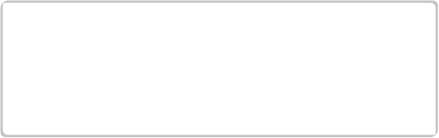








Havoc strategy
A group of fuzzers adopt a random search mechanism namely Havoc, explicitly or implicitly, to augment their edge exploration.
Mutator Stacking
Randomly applying multiple mutators from a finite mutator set to a given seed
Unit-7
Unit-4
Unit-11
Mutant
Seed
Seed corpus
Seed
Unit-1
Chunk-3
Unit-3
Mutant
Unit mutators
Chunk-1
Chunk-4
Unit-10
Mutant
Chunk mutators
Explore new edges ?
No
Mutant
Yes
Discard
Notes:
读框
the workflow of havoc is shown in this figure
augment(o g ment)
First we also select a seed from seed corpus, then we use havoc to generate new mutants.
Overall, havoc enables a mechanims namely mutator stacking. Havoc first defines a stacking size for the applied mutators for each mutation. Accordingly, Havoc randomly select mutators into the stack. Eventually, all the stacked mutators are applied to the seed in order to generate a mutant.
Note that generally havoc enables two types of mutators--chunk mutators and unit mutators. We will introduce their detail later
For mutator stacing, it randomly applies multiple mutators from a finite mutator set to a given seed. For example,

Slide 7
Performance impact of the Havoc
Fuzzers with Havoc: AFL^{[1]} AFL++^{[2]} MOPT^{[3]} FairFuzz^{[4]} QSYM^{[5]}
Fuzzers without Havoc: Neuzz^{[6]} MTFuzz^{[7]}
Pure Havoc
12 projects commonly adopted by the original papers of our studied fuzzers.
Finding 1: Applying Havoc can significantly improve the edge coverage performance of the studied fuzzers.
Finding 2: Havoc is essentially a powerful fuzzer—executing Havoc under one seed without being appended to any fuzzer for sufficient time can already achieve superior edge coverage over many existing fuzzers.
Finding 3: Executing Havoc for a longer time upon a fuzzer can potentially result in stronger edge coverage performance.
Notes:
We first introduce multiple fuzzers in our evaluation. For example, fuzzers with havoc, .....
We also apply 12 projects...

Slide 8





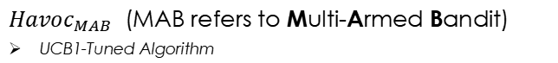
Approach
${Havoc}_{MAB}$ (MAB refers to Multi-Armed Bandit)
UCB1-Tuned Algorithm
Stacking size-level bandit machine enables 7 arms where each arm is designed corresponding to a stacking size choice.
Mutator-level bandit machine enables 2 arms representing chunk and unit mutators.
Update Bandits
NO
2-Bandit
4-Bandit
.C
Program
Seed Corpus
Explore new edges?
Discard
Stacking Size Bandit
…
128-Bandit
Mutator Type Bandits
Stacking Size
Mutator 3
YES
Mutator 1
Mutator 2
Mutator 4
Seed
Mutant
Seed Corpus
Input
Havoc_{MAB} Mutation Stage
Execution
Output
Notes:
It is essential to adapt the selection of the stack size and mutator types for different projects to optimize their respective edge coverage performance.
As a result, we propose havocmab, MAB refers to multi armed bandit.

Slide 9
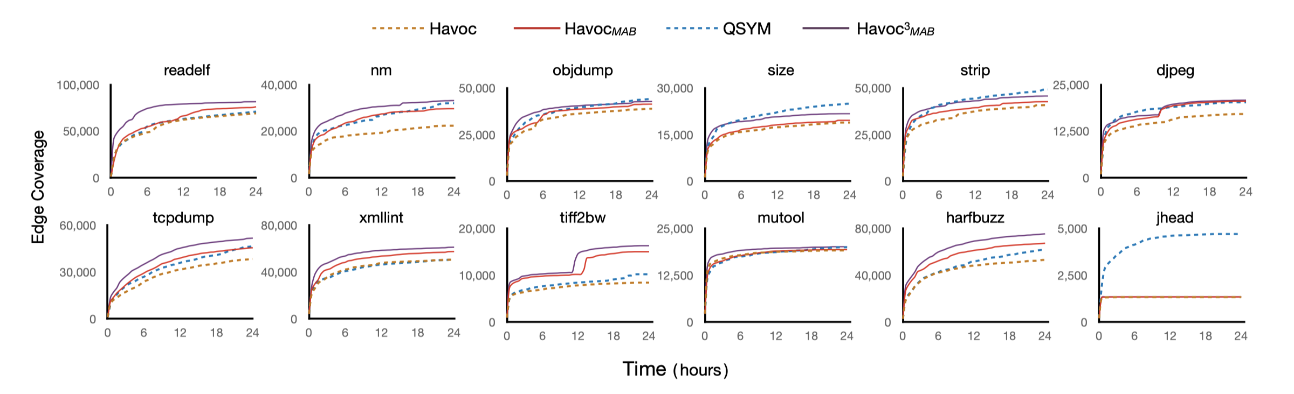
Evaluation results
Havoc vs. Havoc_{MAB}
QSYM vs. Havoc³_{MAB}
Fuzzers | Havoc | Havoc_{MAB} | QSYM | Havoc³_{MAB}
Coverage | 31,126 | 34,574 | 34,495 | 37,614
Havoc³_{MAB} :
Executing Havoc_{MAB} in three threads in parallel
11.1%
9%
Havoc_{MAB} and Havoc underperform QSYM significantly in project jhead! Why?
Notes:
We can observe that Havoc𝑀𝐴𝐵 achieves significantly better performance than pure Havoc. On the other hand, executing Havocmab in three threads can aslo outperform QSYM.

Slide 10
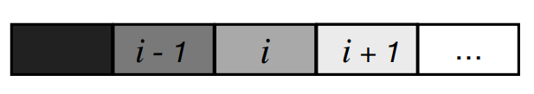
Neural program-smoothing-based fuzzing
Given bytes of a seed, Neuzz and MTFuzz essentially utilize explored edges to compute and rank gradients to derive the bytes for mutation.
Seed
How does such methodology work?
x = 1; z = x + y; if (x > seed[i]) { y = z - x; x ++; } else { x = y; y --; } x = y - z;
x = 1; z = x + y; if (x > seed[i]) {
The gradient of seed[i] to the explored edge e1 should be larger than other bytes after training.
e1
e2
The “promising” byte for e1 is identified after sorting the gradient of each byte and then mutated to explore e2.
y = z - x; x ++;
x = y; y --;
x = y - z;
Notes:
读第一个框
读第二个框
Here is an example. We have a sample program here, as we can see, it has two branches which leads to two edges, e1 and e2. Now, 读框1
读框2

Slide 11
Important Findings
Finding 1: According to the evaluation on a large-scale benchmark suite with a total of 28 real-world projects, the performance of Neuzz and MTFuzz can be largely program-dependent. Interestingly, such program-smoothing-based fuzzers tend to perform better on larger programs.
Finding 2: Randomly selecting bytes for mutations dominates the efficiency of edge exploration among all the studied fuzzing strategies, indicating that it is promising to augment edge exploration by adopting random byte selection mechanism.
Finding 3: Although the gradient guidance mechanisms adopted by Neuzz and MTFuzz are overall effective for identifying the promising bytes, their performance can be rather unstable on some programs.
Finding 4: Different neural network models have limited impact on the effectiveness of program-smoothing-based fuzzing.
Notes:
And we have multiple important findings after evaluating neuzz and mtfuzz.
读

Slide 12

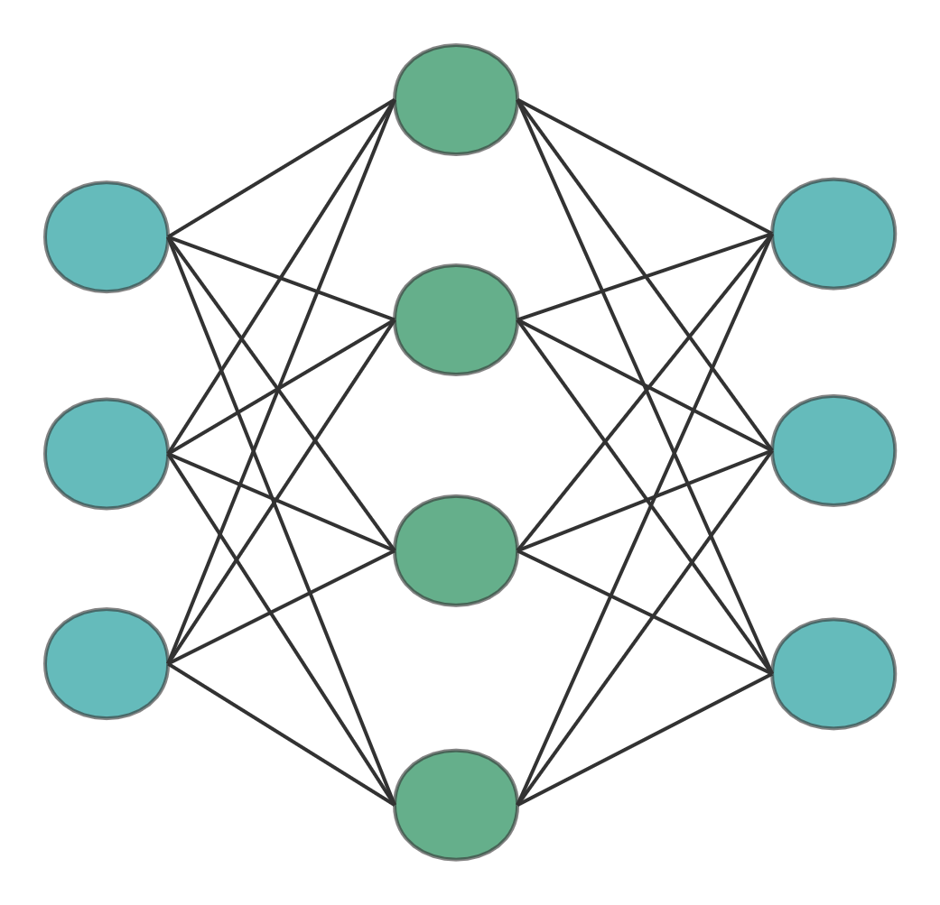

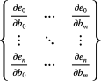

An improved approach
PreFuzz (Probabilistic resource-efficient program-smoothing-based Fuzzing)
…
…
Seed corpus
Edge Selection
NN Training
Identifying the edge worthy being explored
Gradient mutation
PBS
Mutants
Update seed corpus
Gradient Calculation
Random byte selection with gradient information
The evaluation results demonstrate that PreFuzz can significantly outperform Neuzz (by 43.1%) and MTFuzz (by 45.2%) in terms of edge coverage.
Notes:
Inspired by our findings, we propose prefuzz, ()
here is the framework for our approach
PreFuzz first trains a neural network model by applying all the existing seeds as the training set.(点到长条) Next, PreFuzz adopts a resource-efficient edge selection mechanism, which is designed for identifiying the ege worthy being explored, (点到edge selection) to select edges for gradient computation. Then, the gradient information is utilized to generate mutants for fuzzing. (点到gradient) Meanwhile, PreFuzz adopts probabilistic byte selection mechanism, i.e., PBS here, to facilitate mutations.
读最后一个框

Slide 13
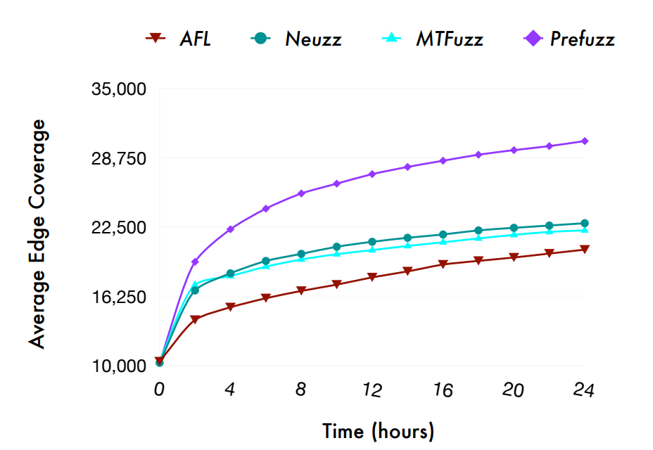
Evaluation
Injecting edge selection to Neuzz
Appending PBS to Neuzz
Fuzzers | AFL | Neuzz | MTFuzz | Neuzz_{Edge} | Neuzz_{Prob} | PreFuzz
Edge Cov. | 20,265 | 22,395 | 22,070 | 24,155 | 28,636 | 32,042
7.9%
27.9%
43.1%
Notes:
We present our evaluation result of PreFuzz as follow. Overall, the evaluation result is promising. First we evaluate the effectiveness of edge selection, neuzzedge outperforms Neuzz by 7.9% averagely. Then we evaluate PBS and neuzzprob outperforms neuzz 27.9%. Finally we can observe that Prefuzz outperforms Neuzz by almost 43.1%

Slide 14
Silver points from the study
Random strategy is very powerful
Random strategy can explore the target program efficiently.
Havoc only can already outperform tons of other fancy approaches significantly.
Random strategy could be less effective in some applications
The fundamental guidance mechanism, coverage guidance, can be less effective when fuzzing some applications.
An application with complicated constraints can easily terminate in the early stage and thus fuzzers cannot explore it efficiently.
Insight 1: can we improve the performance of coverage guidance by gathering more information?
Insight 2: how about we randomly travel in a target program WITHOUT being violating any predefined constraints by gathering limited information?
Notes:
Introduction to neural fuzzing

Slide 15

Enhancing Coverage-Guided Fuzzing via Phantom Program
Although coverage guidance has been shown effective, it is still somewhat restricted to hinder their further performance improvement !
Challenge 1: Only a limited number of seeds can explore a particular branch.
Challenge 2: A seed that satisfies an unexplored branch condition can be discarded if its dependent branches are not accessed yet.
Notes:
research questions in section 3

Slide 16
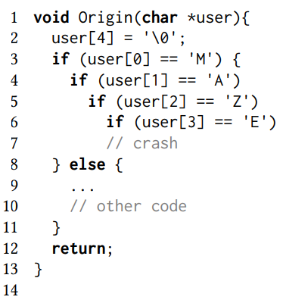
Motivation
Only seeds which successfully satisfy the condition in line 3 can be used to explore line 4!
Seeds satisfying the condition in line 6 can be DISCARDED if they fail to access all dependent branches, e.g., user[2] == ‘Z’.
Exploring program states are bounded by rigorous dependencies between program branches!
Notes:
research questions in section 3

Slide 17
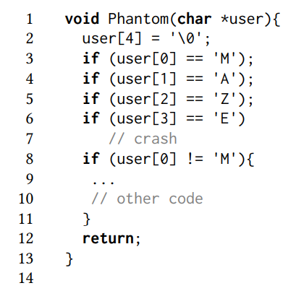
Motivation
Can we reduce the dependencies among different branches?
Insight: creating a “Phantom” program by reducing the program dependencies to assist the fuzzing of original program
Notes:
research questions in section 3

Slide 18




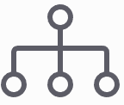








Approach
Discarded
AFL Mutation
New Seed
New Coverage?
Update
Seed Corpus
Phantom
Seed Corpus
Phantom Seeds
Reduce
dependencies
Taint Tracking
Combination
Taint Seed
Seed Corpus
Source
Program
New Coverage?
Update
Seed Corpus
AFL Mutation
New Seed
Discarded
Notes:
research questions in section 3

Slide 19
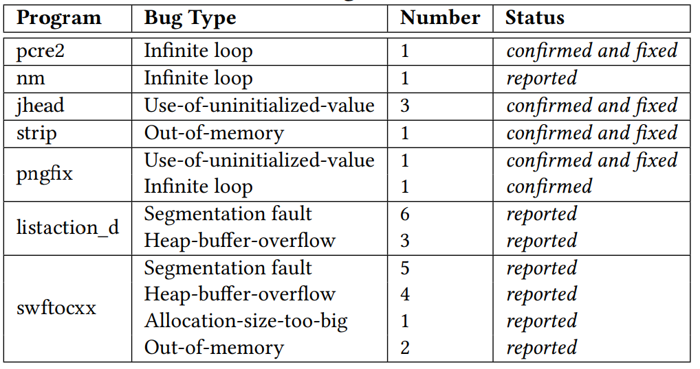
Evaluation results
The evaluation results show that MirageFuzz outperforms the baseline fuzzers from 13.42% to 77.96% in terms of edge coverage averagely in our benchmark. MirageFuzz also exposes 29 previously unknown unique bugs where 7 of them have been confirmed and 6 have been fixed by the corresponding developers.
Notes:
We present our evaluation result of PreFuzz as follow. Overall, the evaluation result is promising. First we evaluate the effectiveness of edge selection, neuzzedge outperforms Neuzz by 7.9% averagely. Then we evaluate PBS and neuzzprob outperforms neuzz 27.9%. Finally we can observe that Prefuzz outperforms Neuzz by almost 43.1%

Slide 20
JITfuzz: Coverage-guided Fuzzing for JVM Just-in-Time Compilers
Based on the aforementioned points, we adopt our findings in a challenge field: Just-in-Time compilers (JIT) in Java Virtural Machine (JVM).
Challenge 1: JITs can hardly be thoroughly tested because they include diverse optimization techniques.
Challenge 2: Executing the mutants generated by existing mutation strategies easily terminates JIT testing early to prevent testing deep JIT states.
Existing JVM testers failed to tackle all these challenges!
Notes:
research questions in section 3

Slide 21
Insights
Challenge 1: JITs can hardly be thoroughly tested because they include diverse optimization techniques.
JIT adopts multiple optimization techniques to strengthen the runtime performance of JVM-based programs.
Control-flow analysis is crutial in the implementation of JITs.
Insight 1: we develop the optimization-activating mutators which aim for extensively triggering the corresponding optimization techniques, and control-
flow-enriching mutators which strengthen the usage and transitions of basic blocks in the seeding class files.
Notes:
In addtion to evolutionary-based fuzzers, researchers proposed neural program-smoothing-based fuzzers to facilitate fuzzing efficacy.
读motivation
读流程图，which requires
读两个图
Recently researchers have proposed two typical neural program-smoothing fuzzers, 读框

Slide 22
Insights
Challenge 2: Executing the mutants generated by existing mutation strategies easily terminates JIT testing early to prevent testing deep JIT states.
How to prevent early termination of JIT while generates more complicated control flow in the seeding class files?
Insight 2:
Statement-wrapping mutator: increasing the number of basic blocks in the existing control flows without devastating their execution.
Transition-injecting mutator: creating new transitions in the existing control flows while preventing early-terminated testing runs, e.g., verification errors.
Notes:
In addtion to evolutionary-based fuzzers, researchers proposed neural program-smoothing-based fuzzers to facilitate fuzzing efficacy.
读motivation
读流程图，which requires
读两个图
Recently researchers have proposed two typical neural program-smoothing fuzzers, 读框

Slide 23







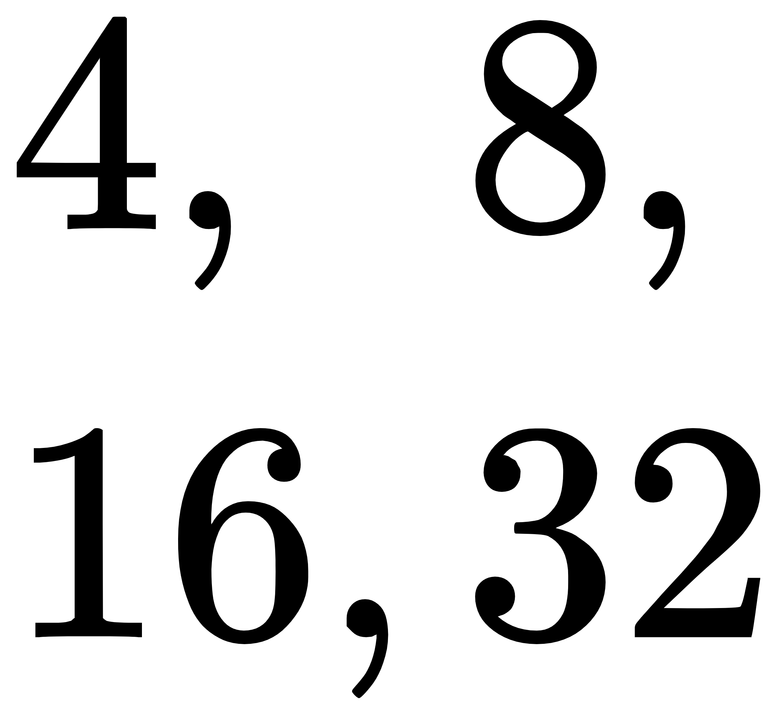





Approach
The framework of JITfuzz
Six mutators to generate new seeding class files for fuzzing.
Diverse Mutators
Selected Mutators
Seed
Mutator Scheduler
A mutator scheduler to select and schedule the mutators and its mutation limits.
Mutation Limits
Mutant
Update
New Coverage?
Edge Coverage
Seed Corpus
Yes
JVM
No
Discard
Notes:
In addtion to evolutionary-based fuzzers, researchers proposed neural program-smoothing-based fuzzers to facilitate fuzzing efficacy.
读motivation
读流程图，which requires
读两个图
Recently researchers have proposed two typical neural program-smoothing fuzzers, 读框

Slide 24
Evaluation results
JITfuzz outperforms Classming by 27.9% and JavaTailor by 18.6% in terms of the code coverage.
Fuzzers | JITfuzz | JavaTailor | Classming
Edge Cov. | 34,939 | 29,451 | 27,306
JITfuzz successfully detects 36 previously unknown bugs where 23 are JIT bugs.
 | JIT | Non-JIT | JIT | Non-JIT | JIT | Non-JIT
OracleJDK | 1 | 0 | 1 | 0 | 0 | 0
OpenJDK | 18 | 5 | 13 | 5 | 7 | 5
OpenJ9 | 4 | 8 | 4 | 4 | 0 | 4
Total | 23 | 13 | 18 | 9 | 7 | 9
Issue reported
Issue confirmed
Issue fixed
Notes:
We present our evaluation result of PreFuzz as follow. Overall, the evaluation result is promising. First we evaluate the effectiveness of edge selection, neuzzedge outperforms Neuzz by 7.9% averagely. Then we evaluate PBS and neuzzprob outperforms neuzz 27.9%. Finally we can observe that Prefuzz outperforms Neuzz by almost 43.1%

Slide 25
SJFuzz: Seed and Mutator Scheduling for JVM Fuzzing
To detect the bugs of JVM, prior research work attempts to integrate fuzzing and differential testing for automated JVM testing, i.e., mutating seeds (i.e., inputs) for executing different JVMs such that their discrepant execution results can be used for testing analytics.
For example:
Classfuzz [1]: mutating their modifiers or variable types to test the loading, linking, and initialization phases in JVMs.
Classming[2]: mutating the control flows in class files to test deeper JVM execution phases (e.g., bytecode verifiers and execution engines) across multiple JVMs.
[1] Chen et al., ''Coverage-directed differential testing of JVM implementations'' PLDI'16
[2] Chen et al., ''Deep differential testing of JVM implementations'' ICSE'19

Slide 26
Challenges of fuzzing JVM
However, code coverage can hardly be applied for JVM testing techniques because JVMs are likely to cause non-deterministic coverage at runtime.
Challenge: The existing JVM fuzzers fail to leverage code coverage as seed/mutator scheduling guidance because they can hardly exploit the runtime coverage information for fuzzing!
Key point: without coverage guidance, WHICH seeds we should retain for the further exploration in order to facilitate the fuzzing efficiency?
Notes:
Now, since 读动机框，we rise our first research question 读问题1
Meanwhile，读第二个动机框，our second research question is

Slide 27
Insights
WHY we need coverage guidance for fuzzing? We want to explore the target program thoroughly. The coverage guidance provides a new “start” for us to explore different parts of the target program. How to adopt similar idea in JVM fuzzing?
Executing the diverse class files potentially leads to trigger different components in the JVM, i.e., exploring different parts of the JVM.
Insight 1: Maintain a set of diverse class files for exploring different parts of the JVM.
Notes:
In addtion to evolutionary-based fuzzers, researchers proposed neural program-smoothing-based fuzzers to facilitate fuzzing efficacy.
读motivation
读流程图，which requires
读两个图
Recently researchers have proposed two typical neural program-smoothing fuzzers, 读框

Slide 28
Insights
Absit omen: when we discover a discrepancy between two JVMs, it may leads to the fact that we are near the “gold mine”, i.e., there are potentially other defects which depend on such a discrepancy can be revealed if we keep exploring it.
Insight 2: retains the class files that can be executed to directly incur inter-JVM discrepancies or used to generate mutants for sufficiently testing JVMs.
We propose SJFuzz, a JVM fuzzing framework which applies seed and mutator scheduling mechanisms based on aforementioned insights to facilitate the the efficiency for JVM differential testing.
Notes:
In addtion to evolutionary-based fuzzers, researchers proposed neural program-smoothing-based fuzzers to facilitate fuzzing efficacy.
读motivation
读流程图，which requires
读两个图
Recently researchers have proposed two typical neural program-smoothing fuzzers, 读框

Slide 29








Approach
The framework of SJFuzz
SJFuzz schedules seeding class files under two types of guidance—discrepancy and diversity.
Append
Class File
Seed Scheduling
Queue
SJFuzz iteratively schedules mutators to augment the overall diverses between seed and mutant class files.
Seed Class
Mutator Scheduling
Method
Mutant
Execute
JVMs
Update Seed’s Estimation
Mutator
Notes:
In addtion to evolutionary-based fuzzers, researchers proposed neural program-smoothing-based fuzzers to facilitate fuzzing efficacy.
读motivation
读流程图，which requires
读两个图
Recently researchers have proposed two typical neural program-smoothing fuzzers, 读框

Slide 30
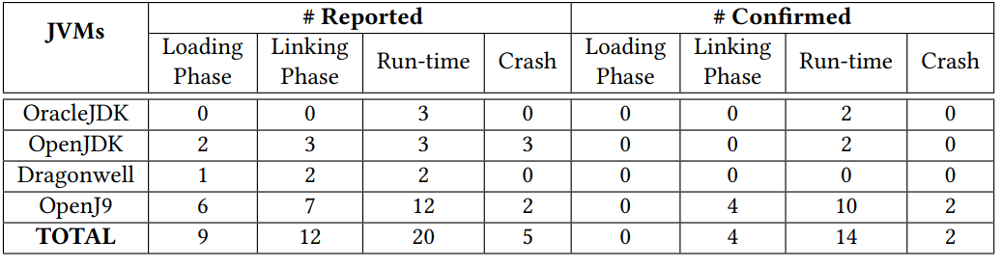
Evaluation results
SJFuzz is effective by exposing 6.3× more unique discrepancies averagely than Classming (8.0 vs. 1.1), and 14.3% more unique discrepancies averagely than JavaTailor (8.0 vs. 7.0) under the same evaluation setups.
SJFuzz successfully detects 20 confirmed bugs and 16 of them have been fixed by the developers.
Notes:
We present our evaluation result of PreFuzz as follow. Overall, the evaluation result is promising. First we evaluate the effectiveness of edge selection, neuzzedge outperforms Neuzz by 7.9% averagely. Then we evaluate PBS and neuzzprob outperforms neuzz 27.9%. Finally we can observe that Prefuzz outperforms Neuzz by almost 43.1%

Slide 31
Future: how should we adopt AI to improve fuzzing?
Can we leverage the power of AI to analysis whether there is a bug?
Different applications have different features, and different tools achieve different performance among different applications.
Different tools even achieve different performance among different components of the same application.
Key insights: how about we use AI to “select” a particular tool for exploring different components of a program?
Notes:
practical guidlines.
suffice (s e fy s)
1.the first one is that 直接读
2. second， we have to 读 because executing such module can be rather heavyweight according to our evaluation
3. Next, 读。The neural program smoothing fuzzers use neural networks for computing gradients to represent the relations between explored edges and seed inputs, obviously we might have multiple ways to achieve this goal.
4. At last, 读。According to our findings, we suggest the users to design such probabilistic search strategy with more guidance to any of their adopted fuzzers when possible

Slide 32

Q/A

Slide 33
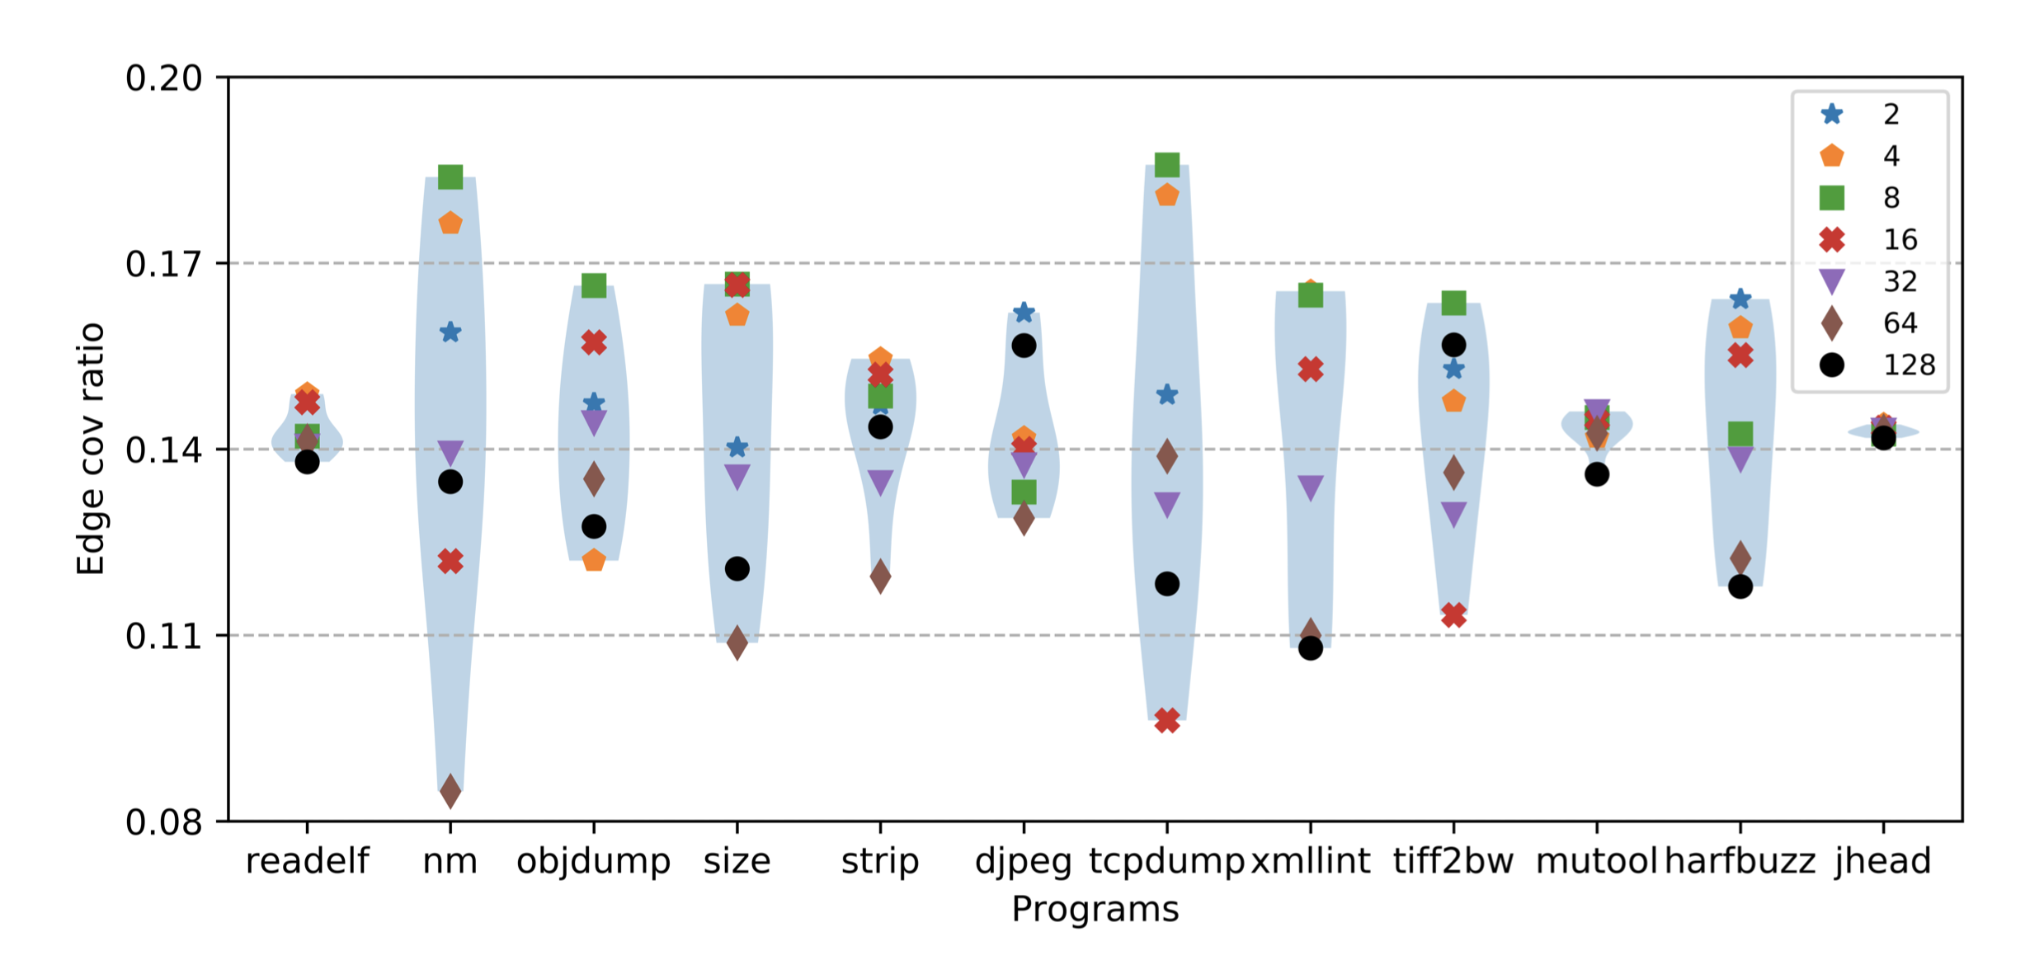
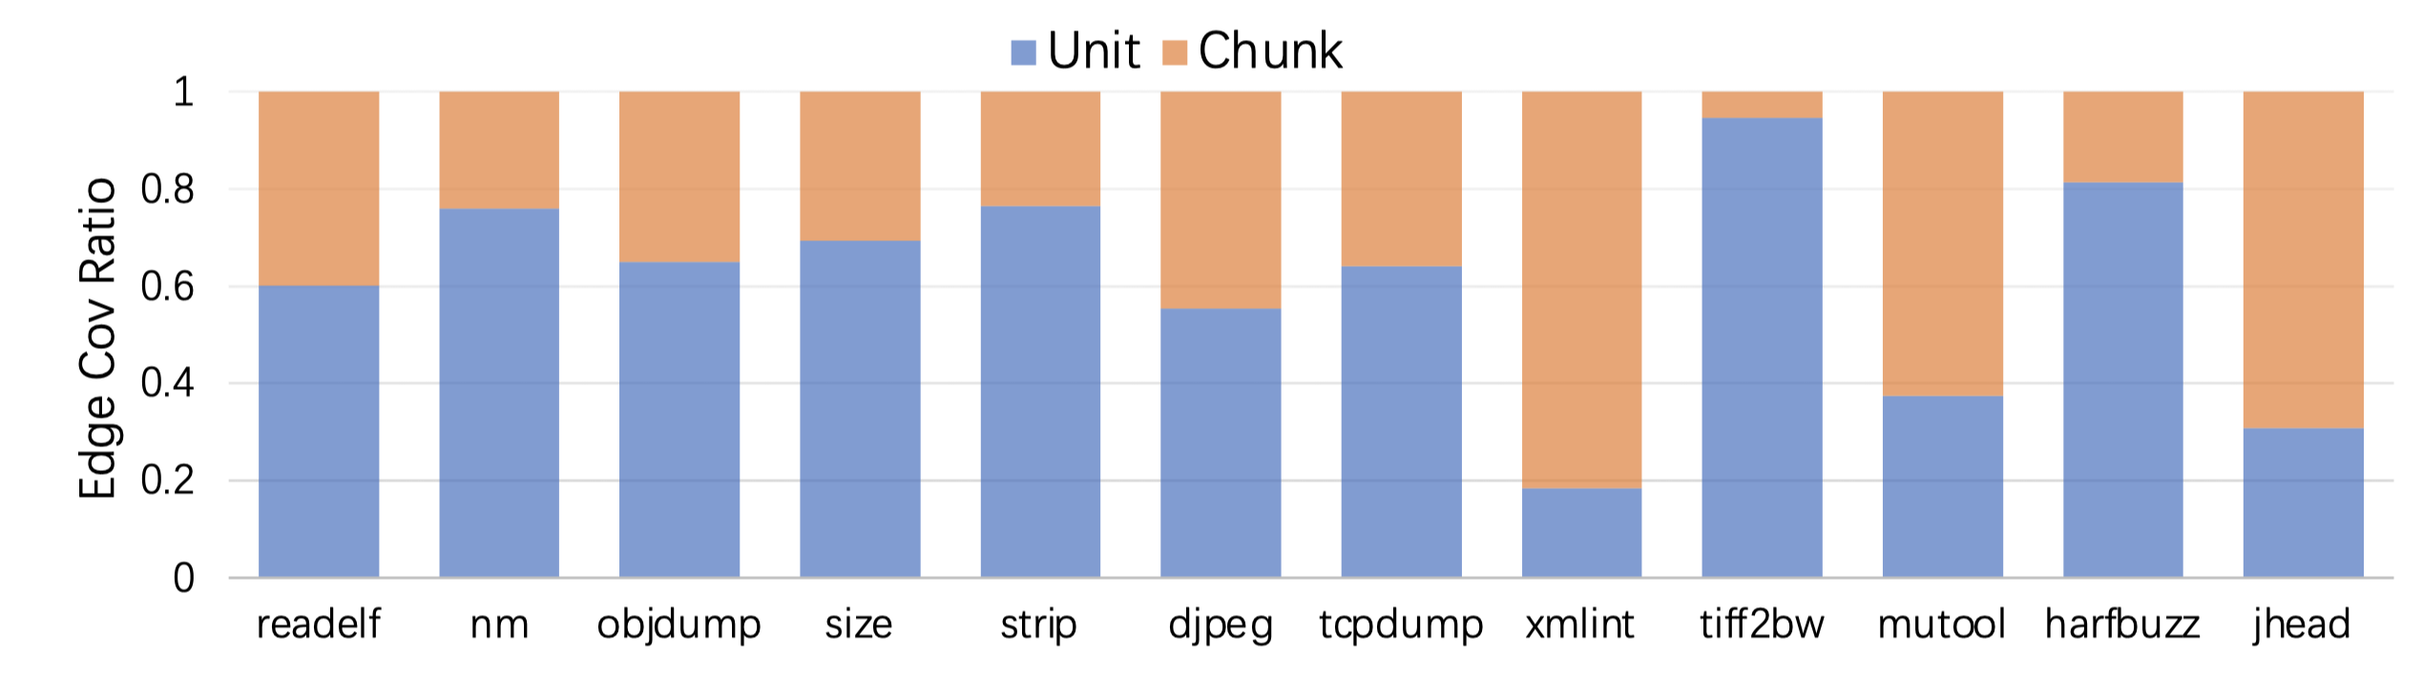
Performance Impact of the Mutator Stacking
Divergent stacking size bias between objdump and djpeg
stacking size
Mutator Stacking determines
and
mutators
Evaluating Havoc under a fixed stacking size.
Stacking size causes divergent optimal edge coverage performance for each project.
Computing edge coverage ratio by either chunk mutators or unit mutators.
Different projects enables divergent distribution of edge coverage ratio.
Divergent mutator bias between xmllint and tiff2bw
Notes:
总起：Note that as a simplified mutation strategy, the mutator stacking mechanism contains two steps: determining stacking size and randomly selecting mutators, to impact the performance of Havoc. We then investigate the performance impact caused by each step
栈大小：We first attempt to investigate the performance impact of stacking size and implement Havoc under a fixed stacking size for all its mutations. This figure presents our evaluation results of the edge coverage ratio results in terms of all the possible fixed stacking size, i.e., 2, 4, 8,...128, on top of all the studied benchmark projects. We can observe that overall, the stacking size which causes the optimal edge coverage performance for each studied project can be quite divergent, e.g., selecting stacking size 8, 2, and 32 can optimize the edge coverage in tcpdump, djpeg, and mutool respectively
Mutator类型：Next, we uniformly select chunk mutators or unit mutators and then randomly select their inclusive mutators under the given stacking size for mutating one seed. This figure presents the edge
coverage ratio results in terms of the selected mutator types on top of all the studied benchmark projects. We can observe that overall, the distribution of the edge coverage ratio performance can be quite divergent among different projects, e.g., the edge coverage ratio of the unit mutators ranges from 18.39% (xmllint) to 94.53% (tiff2bw).

Slide 34


Resource-Efficient Edge Selection Mechanism
Resource-Efficient Edge Selection mechanism identifies the edge worthy being explored for later selecting and mutating its corresponding byte.
b1
Basic blocks
e1
b2
e2
b3
Explored edge
Selected Target Edge
e3
b4
b5
Unexplored edge
Edge Selection Mechanism
Notes:
Basically is about choosing existing edge to calculate gradient.
Intuitively, when one edge can identify the number of its “sibling” edges, such edge number can be a potential indicator whether the given edge should be included for further gradient computation. More specifically, the more “sibling” edges have been explored, the less likely new “sibling” edges can be explored via the gradient computation for the given edge.
For example we have three edges here, which is e1, e2 and e3. basic block here is marked by node and solid line here refers to explored edge, dotted line refers to unexplored edge. For e1 and e2, their sibling edges are all explored so that retrieve gradient information from them might be useless. However, e3 still has an unexplored edge which indicates that mutate the promising byte of e3 can potentially switch to an unexplored edge. Therefore, we add edge e3 to our candidate edge set instead of e1 and e2.
读框

Slide 35
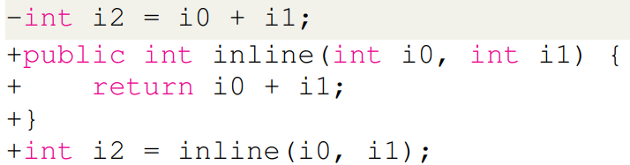
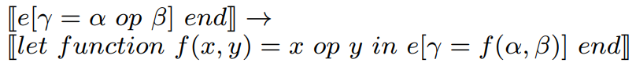
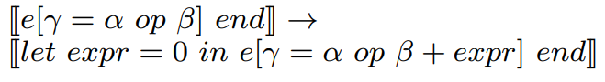
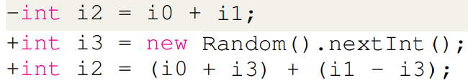
Optimization-activating mutators
Function inlining: merging the instructions of small-scale functions into their callers to reduce the cost of function calls.
Simplification: simplifying an arithmetic expression.
Notes:
In addtion to evolutionary-based fuzzers, researchers proposed neural program-smoothing-based fuzzers to facilitate fuzzing efficacy.
读motivation
读流程图，which requires
读两个图
Recently researchers have proposed two typical neural program-smoothing fuzzers, 读框

Slide 36
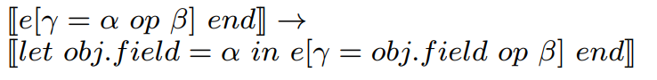
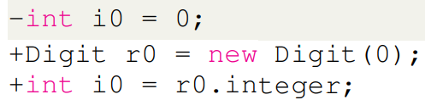
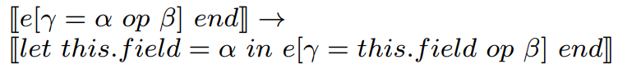
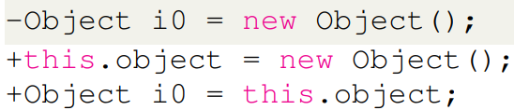
Optimization-activating mutators
Scalar replacement: investigating whether a stack variable can replace an object allocated in the heap in order to save memory resources.
Escape analysis: determining whether an object may escape the method, i.e., is not local to the method.
Notes:
In addtion to evolutionary-based fuzzers, researchers proposed neural program-smoothing-based fuzzers to facilitate fuzzing efficacy.
读motivation
读流程图，which requires
读两个图
Recently researchers have proposed two typical neural program-smoothing fuzzers, 读框

Slide 37

Control-flow-enriching mutators
Statement-wrapping mutator: wrapping a given statement within if and/or loop statement(s) for enriching the control flow and preventing early termination.
int limitation = CNT;
while (CNT >= 0) {
if (true expression) {
Statement;
}
CNT --;
}
if (true expression) {
Statement;
}
Statement;
Notes:
In addtion to evolutionary-based fuzzers, researchers proposed neural program-smoothing-based fuzzers to facilitate fuzzing efficacy.
读motivation
读流程图，which requires
读两个图
Recently researchers have proposed two typical neural program-smoothing fuzzers, 读框

Slide 38
Control-flow-enriching mutators
Transition-injecting mutator: enriching the transitions among basic blocks, i.e., creating new transitions among existing basic blocks.
However, it is likely to cause early-terminated program execution, i.e., the verification error caused by undefined variables.
f1
f2
f7
For example, if we randomly create a transition from to
, this transition definitely causes an undefined variable error and prevents further testing on the deep states of JIT, e.g., the optimization techniques, if depends on the variables defined in its predecessors.
f8
f3
f4
f5
f5
f6
f8
f5
Notes:
In addtion to evolutionary-based fuzzers, researchers proposed neural program-smoothing-based fuzzers to facilitate fuzzing efficacy.
读motivation
读流程图，which requires
读两个图
Recently researchers have proposed two typical neural program-smoothing fuzzers, 读框

Slide 39
Control-flow-enriching mutators
Target: redirecting the transition between two randomly selected basic blocks without causing any errors.
Note that any variables used by basic block is defined either in itself or its dominators. Therefore, the new sink node should be its dominator. But which one we should choose?
, or ?
the immediate post-dominator of their common dominator !
f5
f1
f1
f1
f2
f3
f2
f7
Redirecting to still causes errors if defines variables used in it.
f3
f4
f3
f2
f5
f6
f8
Redirecting to is good but potentially loses diversities.
f1

Slide 40
Phantom creation
How do we reduce dependencies to create a phantom program?
Dominator: a node d of a control-flow graph dominates a node n if every path from the entry node to n must go through d.
①
int a = input(), b = input();
bool cmp1 = (b == 1);
F
②
a = 2; bool cmp2 = (a + b == 3);
T
For example, ① dominates ⑤ and ② dominates ③.
F
T
③
bool cmp3 = (a + b == 4);
Ideally, we aim to relocate all conditional instructions and the instructions affecting them to the program entry point, BUT we cannot!
F
T
⑤
④
T
// do something
bool cmp4 = (a == 2);
⑥
// do something
F
⑦
return 0;
Notes:
research questions in section 3

Slide 41
Phantom creation
①
Question: can we move the instructions in basic block ② to the program entry, which is basic block ①?
int a = input(), b = input();
bool cmp1 = (b == 1);
F
②
a = 2; bool cmp2 = (a + b == 3);
T
F
NO! The semantics of conditional instruction in ⑤ can be changed!
T
③
bool cmp3 = (a + b == 4);
F
⑤ can be relocated to ①, ③ can be relocated to ②.
T
⑤
④
T
// do something
bool cmp4 = (a == 2);
⑥
// do something
F
⑦
return 0;
Solution: we identify the farthest dominator in CFG to which the instructions can be relocated without violating semantics on the conditional instruction.
Notes:
research questions in section 3

Slide 42
Seed scheduling: diversity guidance
We adopt the executed instruction list of a given class file, namely EntryInstruction, as the representative instructions to efficiently measure the diversity (via distance metrics) between JVM class files.
BUT how to measure the distance between JVM class files?
C1
Levenshtein Distance: a metric widely used to derive the “minimum number of single-character edits (insertions, deletions, or substitutions)” between two strings.
I1, I2, I3, I4, ... , In
C2
I1, I3, I4, ... , In
We consider an instruction from EntryInstruction as a “charactler” to calculate Levenshtein distance for different JVM class files.
C1 can be transformed from C2 by only inserting one instruction I2 between I1 and I3. Therefore, their Levenshtein Distance is computed as 1.
Notes:
In addition to evolutionary-based fuzzers, researchers proposed neural program-smoothing-based fuzzers to facilitate fuzzing efficacy.
读motivation
读流程图，which requires
读两个图
Recently researchers have proposed two typical neural program-smoothing fuzzers, 读框

